Slide 1
LDV State Survival Curves
Feb 3rd, 2026
Ruixiao Sun

Slide 2
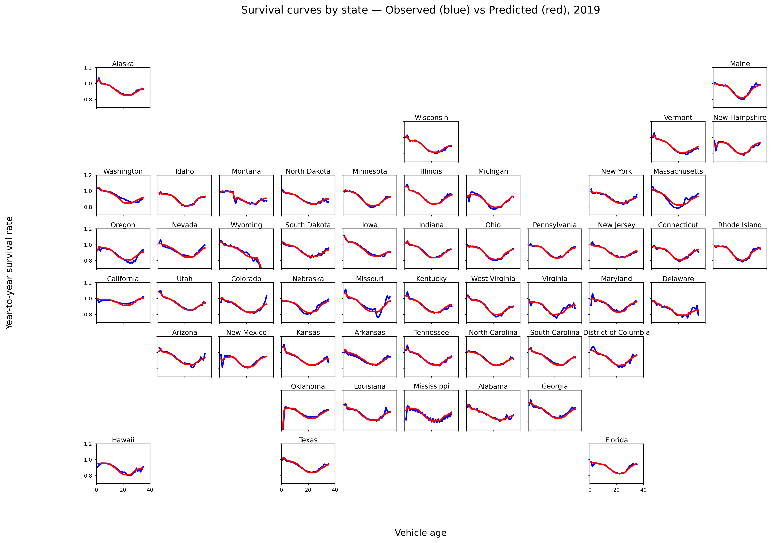
We have found that machine learning can fit accurate survival functions to state data for each state and year.
CARS
2019

Slide 3

We have found that machine learning can fit accurate survival functions to state data for each state and year.
SUV & Van
2019

Slide 4
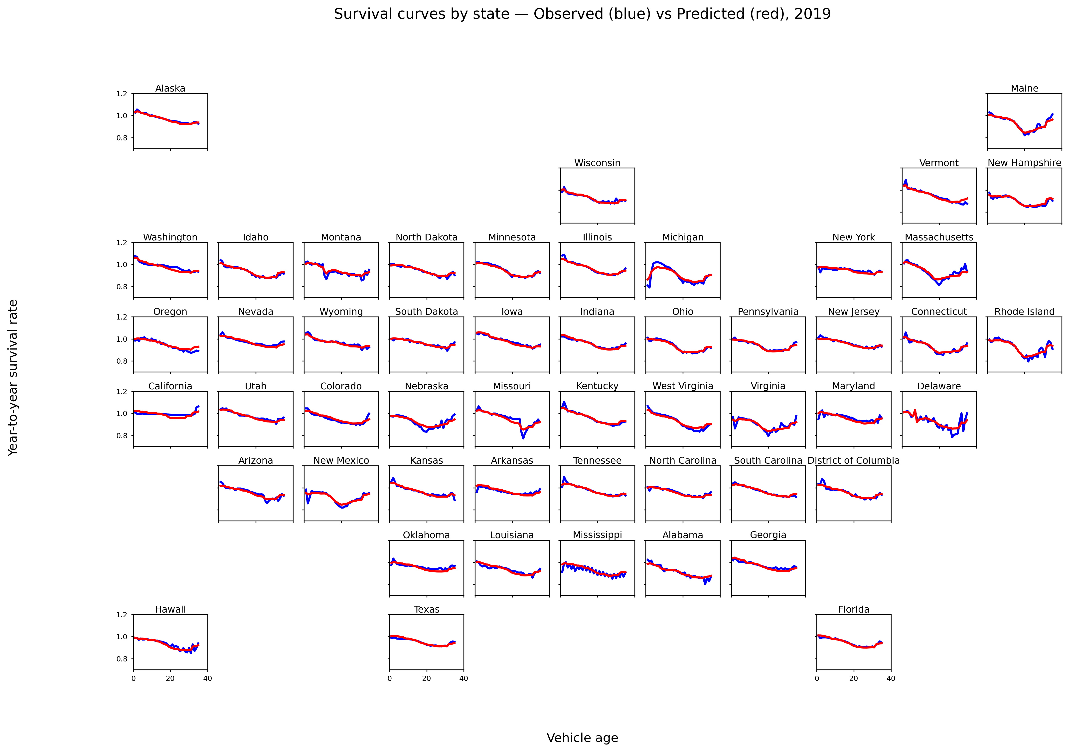
We have found that machine learning can fit accurate survival functions to state data for each state and year.
Pickup
2019

Slide 5
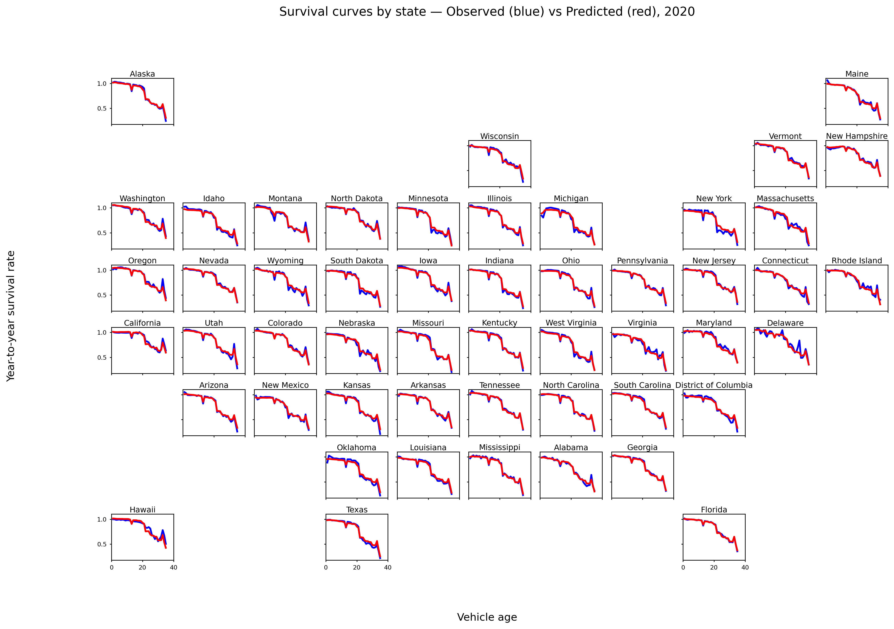
We have found that machine learning can fit accurate survival functions to state data for each state and year.
Pickup
2020

